Slide 1
Brands Ads Airing
File created on: 7/9/2023 4:31:30 PM

Slide 2
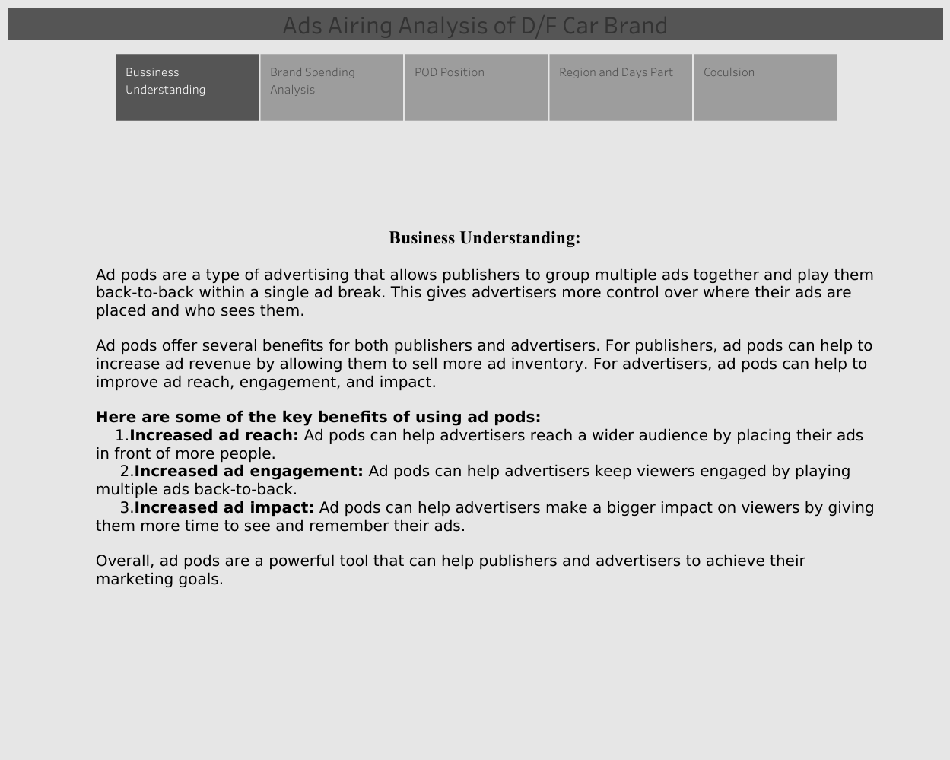

Slide 3
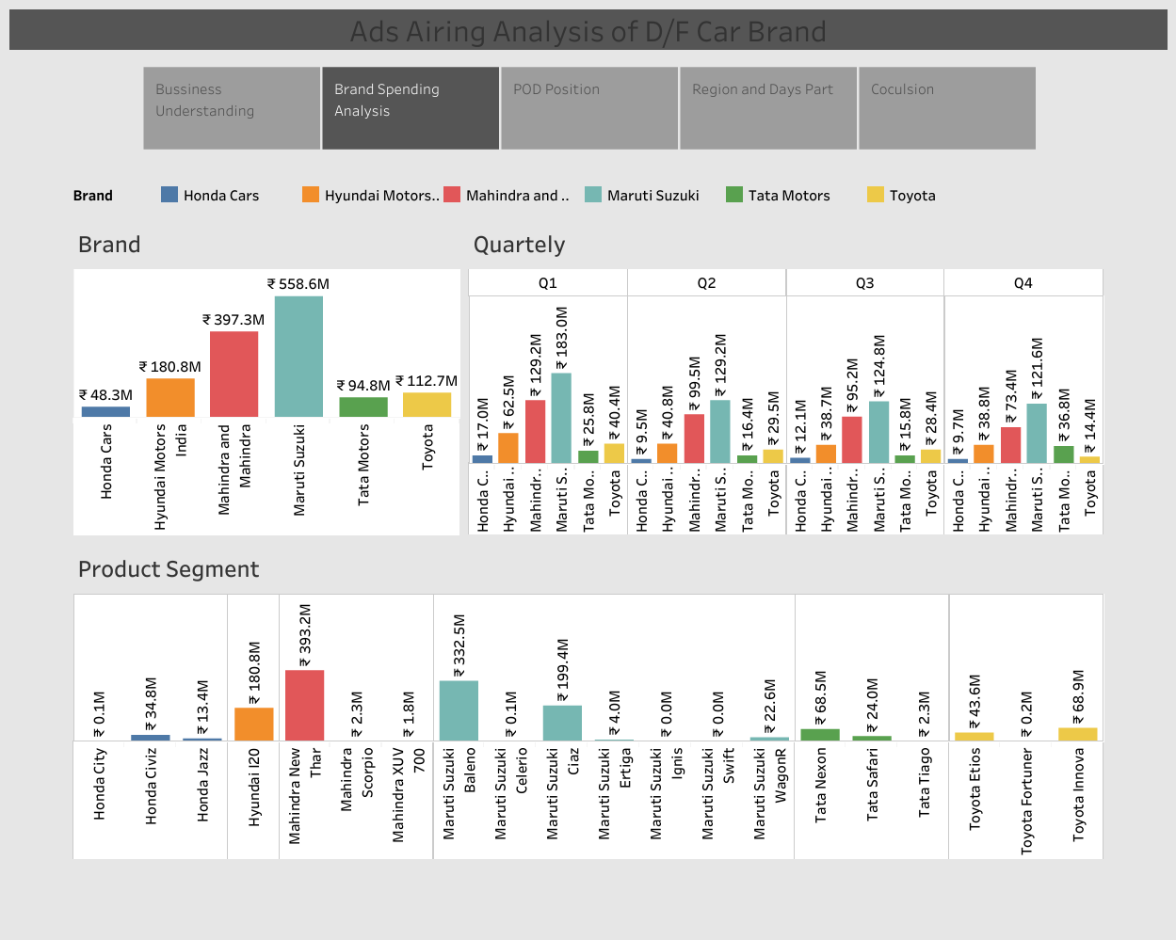

Slide 4
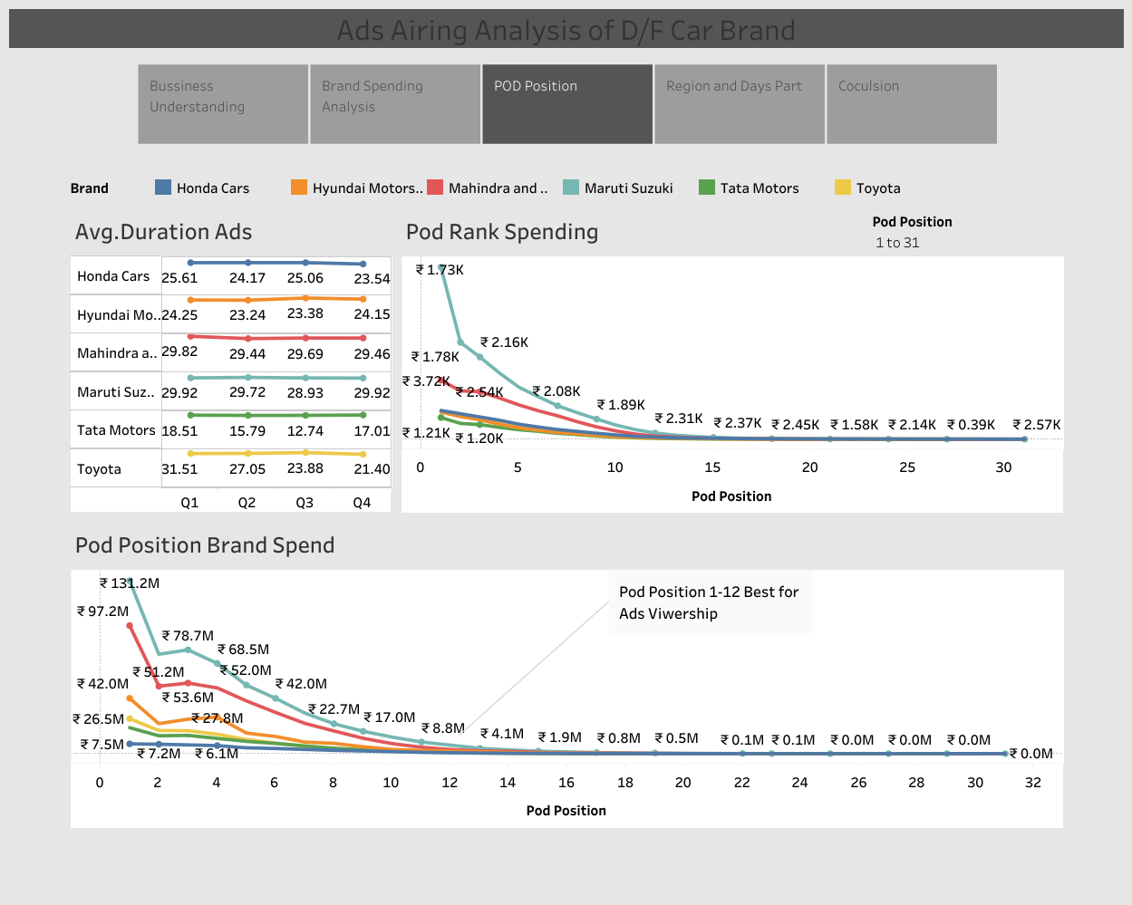

Slide 5
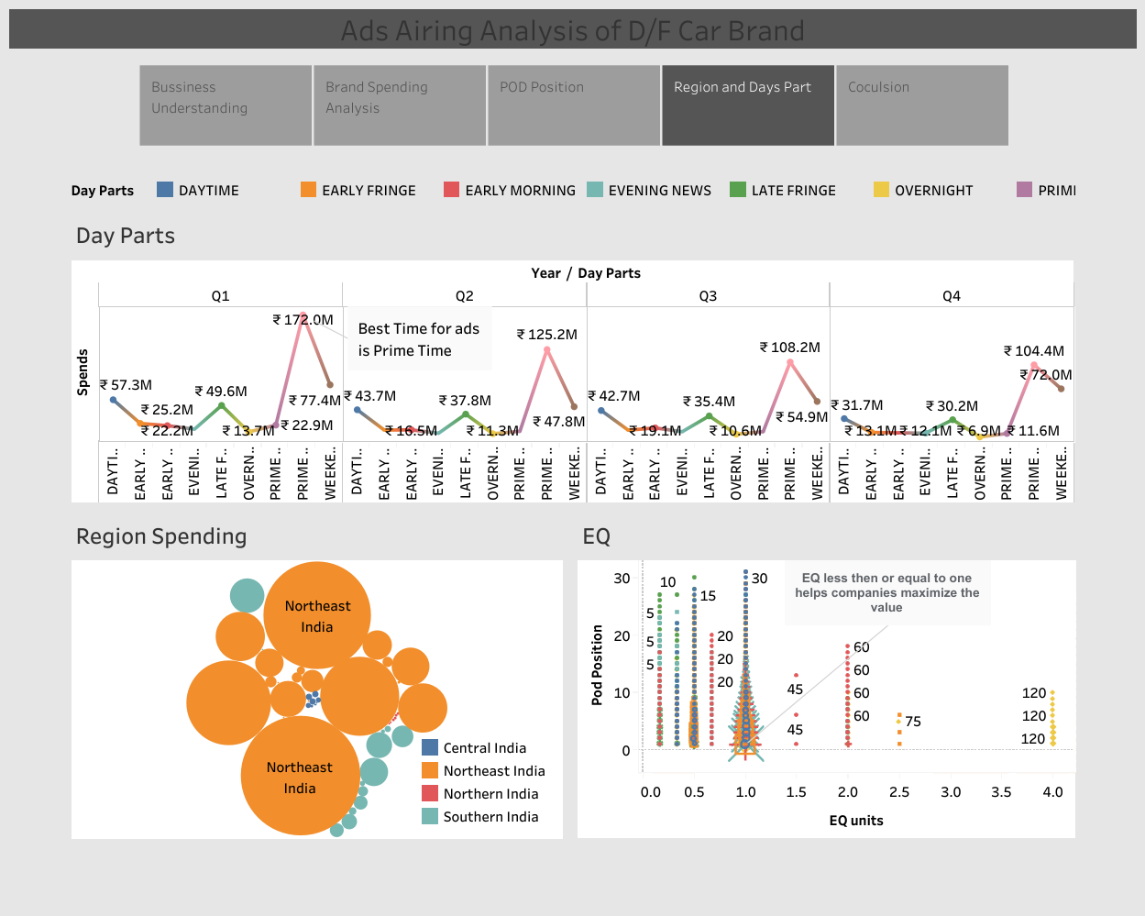

Slide 6
